Slide 1
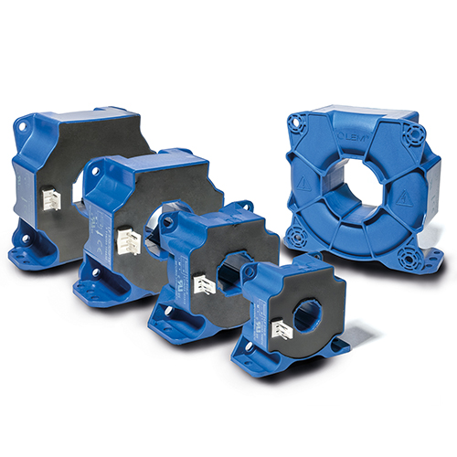
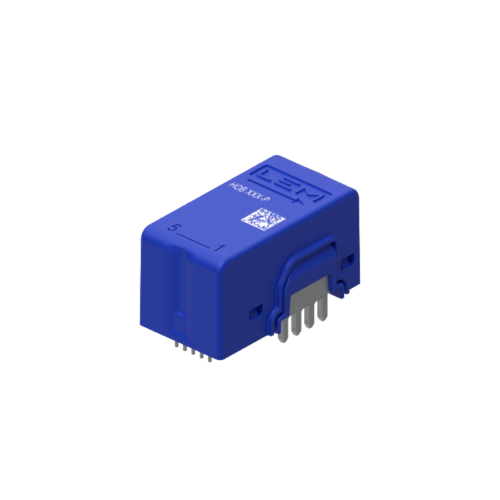


COMPETITIVE INTELLIGENCE STUDY –
XXX
A Report
Prepared For
TSR/2022/373
July 7, 2022
Prepared By
MARKET INTELLIGENCE . CONSULTING
www.techsciresearch.com

Slide 2
Report Content
Sl. No.
Report Content
Page No.
1
RESEARCH METHODOLOGY
4
2
EXECUTIVE SUMMARY & CONCLUSIONS
6-10
3
LEM INTERNATIONAL – COMPETITIVE INTELLIGENCE
12-22
4
DRIVES & WELDING
24-29
5
RENEWABLE ENERGIES
31-36
6
TRACTION
38-41
7
HIGH PRECISION
43-44
7
KEY PARTNER ALLIANCES ACROSS REGIONS - INDUSTRIAL TRANSDUCER BUSINESS DOMAIN
46-48

Slide 3

RESEARCH METHODOLOGY

Slide 4









Research Methodology
The methodology for this study was based on exhaustive Secondary Research followed by extensive Primary Research. TechSci Research deployed a dedicated team who worked dedicatedly for the Client to meet research objectives.
Phase-I: Secondary Search
The team conducted exhaustive secondary research to collect the information on required set of data /information.
Phase-II: Formulating Questionnaire & Developing List of Respondents
Post Secondary Search, TechSci prepared a list of target individuals in target organizations, across different functions and levels. In-addition, TechSci also identified individuals in competitor companies, customers including channel partners
TechSci team formulated guidelines to ask specific questions related with the project objectives.
Phase-III: Extensive Primary Search
TechSci Research executed primary surveys targeting identified individuals in target organizations through Telephonic methodology. TechSci Research performed periodical checks on data collected through telephonic surveys with logic checks and analyze survey results.
Phase IV:
TechSci delivered the final comprehensive project report in detailed PDF format.
Target Audience Identification
Questionnaire Design and Finalization
Survey Execution
Data Cleaning and Validation
Survey Analysis
Reporting

Slide 5

EXECUTIVE SUMMARY & CONCLUSIONS

Slide 6

Executive Summary & Conclusions
Overall Transducers Business Sales, USD Million
Key Findings:
XXX
XXX
XXX
XXX
XXX
XXX
XXX
XXX
XXX
XXX
XXX
XXX
XXX
XXX
XXX
XXX
XXX
XXX
XXX
XXX
XXX
XXX
Transducers sales grew from XXX USD Million in FY2021 to XXX USD Million in FY2022 with Y-o-Y of XXX.
Sales Break-Up By Target Market, USD Million
Industrial transducer sales grew from XXX USD Million in FY2021 to XXX USD Million in FY2022 with Y-o-Y of XXX.
Source: TechSci Research

Slide 7
Executive Summary & Conclusions
Most Prominent Technologies
XXX & XXX Technologies In The Industrial Transducer Offerings
XXX
XXX
XXX
XXX
XXX
Technology | Top 5 Sensors | Market Size, FY2021 | Applications
XXX | XXX | XXX | XXX
XXX | XXX | XXX | XXX
XXX | XXX | XXX | XXX
XXX | XXX | XXX | XXX
XXX | XXX | XXX | XXX
Source: TechSci Research

Slide 8
Executive Summary & Conclusions
Most Prominent Business Domains
Drives & Welding & Renewable Energies In The Industrial Transducer Segment
XXX
XXX
XXX
XXX
XXX
XXX
XXX
XXX
Sales Break-Up By Business Domain, USD Million
Business Domain | FY2017 | FY2021 | FY2022
XXX | XXX | XXX | XXX
XXX | XXX | XXX | XXX
XXX | XXX | XXX | XXX
XXX | XXX | XXX | XXX
XXX | XXX | XXX | XXX
Source: TechSci Research

Slide 9
Executive Summary & Conclusions
Most Prominent Regions
Europe & China In The Industrial Transducer Segment
XXX
XXX
XXX
XXX
XXX
Sales Break-Up By Region, USD Million
Region | FY2017 | FY2021 | FY2022
XXX | XXX | XXX | XXX
XXX | XXX | XXX | XXX
XXX | XXX | XXX | XXX
XXX | XXX | XXX | XXX
XXX | XXX | XXX | XXX
XXX | XXX | XXX | XXX
Source: TechSci Research

Slide 10
Executive Summary & Conclusions
Direct Customers - Industrial Transducer Business Domain
Company Name | Location | Type | Basic Description
XXX | XXX | XXX | XXX
XXX | XXX | XXX | XXX
XXX | XXX | XXX | XXX
XXX | XXX | XXX | XXX
XXX | XXX | XXX | XXX
XXX | XXX | XXX | XXX
Source: TechSci Research

Slide 11
XXX – COMPETITIVE INTELLIGENCE

Slide 12
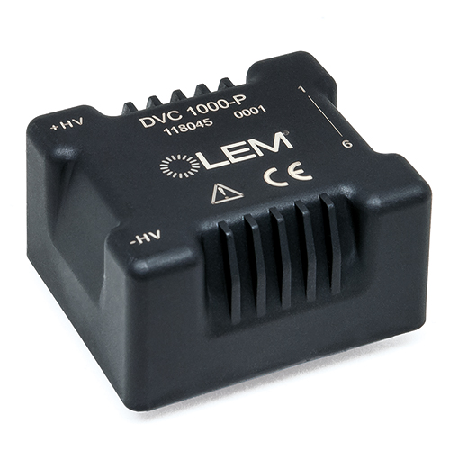
XXX
XXX
XXX
XXX
XXX
XXX
XXX:
XXX
XXX
XXX
XXX
XXX
XXX
XXX
XXX
XXX
Key Factors Impacting The Industrial Segment Revenue (FY 2022)
XXX | Small & medium power applications & manufacturing capacity investment in semiconductors are major drivers of drives & welding segment.
Renewable Energies | China market is driven by growth in solar power demands in infrastructure. Europe market growth boosted by DC meter applications.
Traction | Majority of the demand is from Europe and India.
High Precision | Increasing demand for new product families in test and measurement is driving the market demand.
Source: LEM International Website & Annual Reports

Slide 13
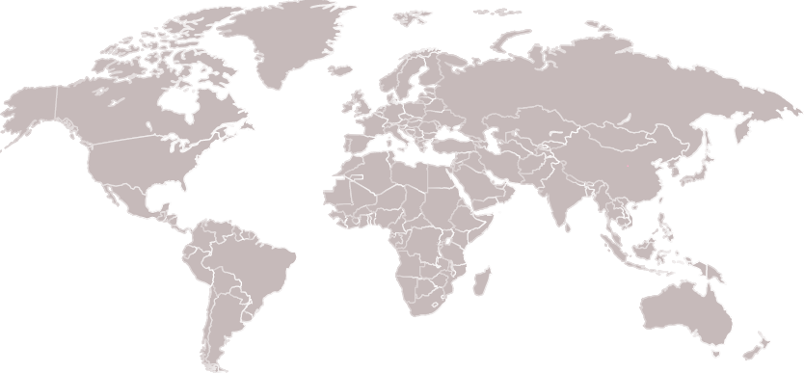
XXX
Sales Offices (23) | Europe- Geneva (Switzerland), Frankfurt (Germany), Vienna (Austria), Brussels (Belgium), Randers (Denmark), Paris (France), Padova (Italy), Skelmersdale (UK), Lyon (France) and Sofia (Bulgaria), China- Beijing, Shanghai, Shenzhen, Xian, Heifei, and Taipei (Taiwan), North America- Milwaukee (Wisconsin), Columbus (Ohio), Amherst (Massachusetts) and Los Angeles (California) , Rest of World- Pune (India), Seoul (South Korea), Tokyo (Japan) and Tver (Russia)
Production(5) | Europe- Geneva (Switzerland) and Sofia (Bulgaria), China- Beijing, Rest of World- Tokyo (Japan) and Tver (Russia)
R&D (4) | Europe- Geneva (Switzerland) , Lyon (France) and Sofia (Bulgaria), China- Beijing
Source: LEM International Website & Annual Reports

Slide 14
XXX
Overall Transducers Business Sales, 2017-2021, USD Million
Overall Industrial Transducers Business Sales By Mode (Direct, Partners), FY2021 & FY2022, USD Million
Sales | FY2021 | FY2022
Partners | 203 | 257
Direct | 35 | 54
FY2021
Sales Break-Up By Target Market, 2017-2021, USD Million
FY2022
Source: Primary Research, LEM International Website & Annual Reports

Slide 15
XXX
Overall Industrial Transducers Business Sales By Top 5 Sensors, FY2021, USD Million
Product | Market Size, FY2021 | Technology | Applications | Sub-Applications | Advantages | Standards
LAH25 NP | 16 | Closed loop Hall effect | Drives & Welding Renewable Energies | AC Variable Speed Drives and Servo Motor Drives Static Converters for DC Motor Drives Battery Supplied Applications Uninterruptable Power Supplies (UPS) Switched Mode Power Supplies (SMPS) Power Supplies for Welding Applications | Excellent Accuracy Very Good Linearity Low Temperature Drift Optimized Delay Time No Insertion Loses High immunity to External Interference Current Overload Capability | EN 50178: 1997
HXS 50-NP | 11 | Open loop Hall effect | Drives & Welding Renewable Energies | AC Variable Speed Drives and Servo Motor Drives Static Converters for DC Motor Drives Battery Supplied Applications Uninterruptable Power Supplies (UPS) Switched Mode Power Supplies (SMPS) Power Supplies for Welding Applications | Small Size and Space Savings Only One Design for Wide Current ratings Range High immunity to External Interference | EN 50178: 1997
LA25-NP | 8 | Closed loop Hall effect | Drives & Welding Renewable Energies Traction | AC Variable Speed Drives and Servo Motor Drives Static Converters for DC Motor Drives Battery Supplied Applications Uninterruptable Power Supplies (UPS) Switched Mode Power Supplies (SMPS) Power Supplies for Welding Applications | Excellent Accuracy Very Good Linearity Low Temperature Drift Optimized Delay Time Wide Frequency Bandwidth No Insertion Loses High immunity to External Interference Current Overload Capability | EN 50178: 1997
Source: Primary Interviews, LEM International Website & Annual Reports

Slide 16
XXX
Overall Industrial Transducers Business Sales By Top 5 Sensors, FY2021, USD Million
Product | Market Size, FY2021 | Technology | Applications | Sub-Applications | Advantages | Standards
HAL-50S | 5 | Open loop Hall effect | Drives & Welding Renewable Energies | AC Variable Speed Drives and Servo Motor Drives Static Converters for DC Motor Drives Battery Supplied Applications Uninterruptable Power Supplies (UPS) Switched Mode Power Supplies (SMPS) Power Supplies for Welding Applications | Easy installation Low Power Consumption Small Size and Space Savings Only One Design for Wide Current ratings Range High immunity to External Interference | EN 50178: 1997 UL 508: 2010
HO-6P | 3 | Open loop Hall effect | Drives & Welding Renewable Energies | AC Variable Speed Drives and Servo Motor Drives Static Converters for DC Motor Drives Battery Supplied Applications Uninterruptable Power Supplies (UPS) Switched Mode Power Supplies (SMPS) Power Supplies for Welding Applications MPPT Combiner Box | Small Size and Space Savings Only One Design for Wide Current ratings Range High immunity to External Interference 8 mm creepage/clearance High insulation Capability Fast Response | EN 50178: 1997 UL 508: 2010 IEC 61010-1: 2010 IEC 61326-1: 2012
Source: Primary Interviews, LEM International Website & Annual Reports

Slide 17
XXX
Sales Break-Up By Business Domain, 2017-2021, USD Million
Business Domain | FY2017 | FY2018 | FY2019 | FY2020 | FY2021 | FY2022
Drives & Welding | 104 | 118 | 114 | 103 | 104 | 141
Renewable Energies | 65 | 78 | 77 | 81 | 86 | 114
Traction | 36 | 47 | 49 | 53 | 40 | 46
High Precision | 9 | 10 | 11 | 11 | 8 | 10
Total | 214 | 253 | 251 | 249 | 239 | 311
Drives & Welding is the leading revenue segment with 45% market share in FY2022 and 43% share in FY2021. Renewable energies is the second largest segment with approximately 37% revenue share in FY2022 and 36% share in FY2021.
Sales Break-Up By Region, 2017-2021, USD Million
Region | FY2017 | FY2018 | FY2019 | FY2020 | FY2021 | FY2022
Europe | 84 | 102 | 103 | 95 | 87 | 115
China | 64 | 79 | 73 | 76 | 84 | 106
North America | 27 | 27 | 29 | 27 | 23 | 29
Japan | 19 | 21 | 21 | 21 | 20 | 26
Rest of the World | 20 | 24 | 25 | 30 | 25 | 36
Total | 214 | 253 | 251 | 249 | 239 | 311
Europe is the largest revenue market for LEM International. In FY2022, Europe contributes to 37% share in LEM’s overall industrial transducer revenue as compared to 36% in FY2021. China is the second largest market for industrial transducer business with 34% share in FY2022 and 35% in FY2021.
Source: Primary Research, LEM International Website & Annual Reports

Slide 18
XXX
Sales Break-Up By Business Domain, By Region, 2017-2021, USD Million
Drives & Welding
Region | FY2017 | FY2018 | FY2019 | FY2020 | FY2021 | FY2022
Europe | 42 | 49 | 48 | 41 | 39 | 54
China | 33 | 38 | 35 | 33 | 38 | 50
North America | 14 | 14 | 14 | 12 | 11 | 14
Japan | 10 | 10 | 10 | 9 | 9 | 12
Rest of the World | 6 | 7 | 7 | 8 | 7 | 11
Total | 104 | 118 | 114 | 103 | 104 | 141
Renewable Energies
Region | FY2017 | FY2018 | FY2019 | FY2020 | FY2021 | FY2022
Europe | 26 | 32 | 32 | 32 | 32 | 43
China | 20 | 25 | 23 | 26 | 31 | 40
North America | 8 | 8 | 9 | 9 | 8 | 10
Japan | 6 | 6 | 6 | 7 | 7 | 9
Rest of the World | 5 | 6 | 6 | 9 | 8 | 11
Total | 65 | 78 | 77 | 81 | 86 | 114
Traction
Region | FY2017 | FY2018 | FY2019 | FY2020 | FY2021 | FY2022
Europe | 13 | 18 | 19 | 19 | 14 | 16
China | 9 | 12 | 12 | 14 | 12 | 13
North America | 4 | 4 | 5 | 5 | 3 | 4
Japan | 3 | 3 | 3 | 4 | 3 | 3
Rest of the World | 7 | 9 | 9 | 11 | 9 | 11
Total | 36 | 47 | 49 | 53 | 40 | 46
High Precision
Region | FY2017 | FY2018 | FY2019 | FY2020 | FY2021 | FY2022
Europe | 3 | 3 | 4 | 4 | 2 | 3
China | 2 | 3 | 3 | 3 | 3 | 3
North America | 1 | 1 | 1 | 1 | 1 | 1
Japan | 1 | 1 | 1 | 1 | 1 | 1
Rest of the World | 2 | 2 | 2 | 2 | 2 | 2
Total | 9 | 10 | 11 | 11 | 8 | 10
Source: Primary Research, LEM International Website & Annual Reports

Slide 19
Factors Influencing The Purchase Decision
Drives & Welding
Note: Based on the perception among customers, partners ( Dealers , Distributors)
The percentage is as per number of respondents choosing a factor at number one priority.
For example, 71% respondents are choosing Brand Awareness as number one priority while making a purchase decision
Source: TechSci Research

Slide 20
Factors Influencing The Purchase Decision
Renewable Energies
Note: Based on the perception among customers, partners ( Dealers , Distributors)
The percentage is as per number of respondents choosing a factor at number one priority.
For example, 68% respondents are choosing Performance as number one priority while making a purchase decision
Source: TechSci Research

Slide 21
Factors Influencing The Purchase Decision
Traction
Note: Based on the perception among customers, partners ( Dealers , Distributors)
The percentage is as per number of respondents choosing a factor at number one priority.
For example, 67% respondents are choosing Brand Awareness as number one priority while making a purchase decision
Source: TechSci Research

Slide 22
High Precision
Factors Influencing The Purchase Decision
Note: Based on the perception among customers, partners ( Dealers , Distributors)
The percentage is as per number of respondents choosing a factor at number one priority.
For example, 70% respondents are choosing Performance as number one priority while making a purchase decision
Source: TechSci Research

Slide 23
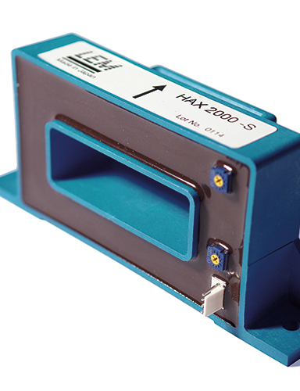
DRIVES & WELDING

Slide 24
Key Sensors, By Technology
Technology | Series | Sub-Applications | Advantages | Standards
Closed loop Fluxgate C type | CV3 series CV4 series | Single or three phase inverters Propulsion and braking choppers Propulsion converters Auxiliary converters Battery chargers AC variable speed drives and servo motor drives Static converters for DC motor drives Uninterruptible Power Supplies (UPS) Power supplies for welding applications Railway overhead line voltage measurement. | Excellent accuracy Very good linearity Low temperature drift Optimized response time Wide frequency bandwidth High immunity to external interference Low Disturbance in Common Mode No insertion losses Current overload capability Low Response Time High Bandwidth | EN 50155: 2007 EN 50121-3-2: 2015 EN 50178: 1997 EN 50155: 2007 EN 50121-3-2: 2016 IEC 61010-1
Closed loop Fluxgate CAS-CASR-CKSR type | CAS-NP series CASR-NP series CAS-NP series CKSR-NP series | AC variable speed and servo motor drives Static converters for DC motor drives Battery supplied applications Uninterruptible Power Supplies (UPS) Switched Mode Power Supplies (SMPS) Power supplies for welding applications Solar inverters. | Very low temperature coefficient of offset Very good dv/dt immunity Higher creepage distance/clearance Reduced height Reference pin with two modes: Ref IN and Ref OUT Extended measuring range for unipolar measurement LTSR compatible footprint | EN 50178: 1997 UL 508: 2013 IEC 61010-1: 2010 IEC 60950-1: 2006 IEC 61326-1: 2012
Closed loop Fluxgate CTSR type | CTSR series | Wide Aperture Residual Current Measurement Leakage Current Measurement in Transformer less PV Inverters First Human Contact Protection of PV arrays Failure Detection in Power Sources Symmetrical Fault Detection (e.g. After Motor Inverter) Leakage Current Detection in Stacked DC Sources Single Phase or Three Phase Nominal Current Measurement up to +-30 A Per Wire (DC or AC) | High Accuracy Very Low Offset Drift Over Temperature High Overload Capacity High Insulation Capacity Reference Pin With Two Modes, Ref IN and Ref OUT Degauss and Test Functions Possibility to Add up to Four Primary Wires (diameter 4.2 mm max) in Addition to the Already Integrated Primary Conductors | EN 50178: 1997 IEC 61010-1: 2010 UL 508: 2010
Source: LEM International Website

Slide 25
Key Sensors, By Technology
Technology | Series | Sub-Applications | Advantages | Standards
Closed loop Hall effect | LA100P series LA125 series LA130150 series LA200P series LA205 series LA255 series LA25NP series LA305 series LA306 series LA35NP series LA55 series LAH series LAH125 series LAX100NP series LES series LESR series LF1005S series LF1010-S series LF2005 series LF2010-S series LF205 series, & LF210-S series LF305 series LF306 series, & LF310-S series LF505S series, & LF510-S series LH series LKSR series, & LPSR series LT10000 series LT1005 series LT2005 series LT4000 series, & LT505 series LV100 series, & LV100xx series LV200 series LV25 series LV25xx series, & LXS series LXSR series LZSR-P series, & LZSR-TP series | AC variable speed drives and servo motor drives Static converters for DC motor drives Battery supplied applications Uninterruptible Power Supplies (UPS) Switched Mode Power Supplies (SMPS) Power supplies for welding applications Solar inverters Windmill inverters Test and measurement Substations Single or three phase inverter Propulsion and braking chopper Propulsion converter Auxiliary converter Battery charger Railway overhead line voltage measurement | Excellent accuracy Very good linearity Low temperature drift Optimized response time Wide frequency bandwidth No insertion losses High immunity to external interference Current overload capability. Optimized delay time Height less than 16.5 mm for a simplified integration with power modules Low primary inductance Very low offset drift Very good dv/dt immunity CAS footprint compatible CASR footprint compatible Reference pin with two modes: Ref IN and Ref OUT Extended measuring range for unipolar measurement CKSR footprint compatible Low disturbance in common mode. Low thermal drift interference LTS footprint compatible LTSR footprint compatible | EN 50178: 1997 UL 508: 2010 EN 50178 UL508 - UR marking IEC 61010-1-safety IEC 61800-1: 1997 IEC 61800-2: 2015 IEC 61800-3: 2004 IEC 61800-5-1: 2007 IEC 62109-1: 2010 IEC 62477-1: 2012 UL 508:2013 IEC 61010-1: 2010 IEC 61800-1: 2004 IEC 61800-3: 2011 EN 50155: 2017 EN 50121-3-2: 2016 EN 50155: 2021 EN 50178 (01.10.97) IEC 61800-3: 2017 UL 508: 2018
Source: LEM International Website

Slide 26
Key Sensors, By Technology
Technology | Series | Sub-Applications | Advantages | Standards
Open loop Hall effect | AHR series DHR series, & DK series GO-SME series GO-SMS series HAC/HEC series HAIS series HAL series HAS series, &HASS series HAT series HAX series, & HAZ series HLSR series HLSR-PW series HLSR-SM series HMSR-SMS series HO series, &HO-P series HOB series, &HOP series HOxx-NP- series HOxx-NPW series HOxx-P- series HOxx-PW- series HOxx-S- series HOxx-SW- series HOYL series HOYS series HTA series, &HTB series HTFS series, & HTR series HX series, & HXN series HXS series HY series LA306 series | AC power supplies or Motors True RMS current sensing VFD Controlled Loads VFD output current monitoring SCRs or Switch-mode Rectifiers Renewable Energy Installations or Backup Batteries Continuous condition monitoring SCR Controlled Loads Switching Power Supplies and Electronic Ballasts Battery Banks, Power Supplies Small drives HVAC inverters, and Solar inverters AC variable speed drives and servo motor drives Static converters for DC motor drivers Battery supplied applications Uninterruptible Power Supplies (UPS) Switched Mode Power Supplies (SMPS) Power suppliers for welding applications DC motor drives, & Combiner box Solar inverter on DC side of the inverter (MPPT) Plasma cutter, welding Charging station Power supplies for TELECOM (monitoring & measuring) Chopper, Forklift Devices, and Electrical appliances Battery supplied application General purpose inverters | High insulation between primary and secondary circuits Eliminates insertion loss Large aperture for cable up to Ø32mm High isolation between primary and secondary circuits Extended Measuring Range Open loop multi-range current transducer Low electrical resistance Dual supply voltage Low power consumption High bandwidth No magnetic hysteresis Galvanic separation between primary and secondary Insulated test voltage Small footprint with standard surface mount PCB mounting Dual overcurrent detection Small size and space saving Only one design for wide current ratings range High immunity to external interference Extremely low profile Over-drivable Vref & Uref Reinforced insulation capability High resolution Lightning impulse current ≤ 20 kA. High insulation capability Fast Response High cut-off frequency > 1 MHz Very good linearity, and accuracy Low temperature drift Wide frequency bandwidth Easy to mount split core with automatic handling system | EN 50178: 1997 IEC 61010-1 IEC 61010-1 : 2001 IEC 61326-1: 2005 IEC 61800-5-1: 2007 IEC 62109-1: 2010 IEC 62368-1:2018 UL 1577: 2014 UL 62368: 2019 UL 508:2010 IEC 61000-6-2:2016 IEC 61800-3:2017 IEC 61010-1:2010 IEC 61477-1:2012 IEC 61800-2:2012 UL 508: 2013 EN 50155: 2007 EN 50121-3-2: 2006 IEC 61010-1: 2010 IEC 61326-1: 2012 UL 508: 2010 IEC 61800-2: 2015 IEC 61800-3: 2017 IEC 60950-1: 2005 IEC 61010-1: 2017 IEC 61010-2-30: 2017 IEC 61800-1: 1997 IEC 61800-3: 2004 EN 50178: 1998 EN 50178: 1999
Source: LEM International Website

Slide 27
Key Sensors, By Technology
Technology | Series | Sub-Applications | Advantages | Standards
Eta (Hall Effect) | LAS series | AC variable speed drives and servo motor drives Static converters for DC motor drives Battery supplied applications Uninterruptible Power Supplies (UPS) Switched Mode Power Supplies (SMPS) Power supplies for welding applications. | Excellent accuracy Very good linearity Low temperature drift Optimized response time Wide frequency bandwidth No insertion losses High immunity to external interference Current overload capability. | EN 50178: 1997
Fluxgate | CAB-SF series | Hybrid and electric vehicle battery pack Conventional lead-acid batteries Accurate current measurement for battery management applications (SOC, SOH, SOF, etc). | Offset below 10 mA Total error [−40 °C to 85 °C] 0.5 % typical total error at 1-sigma 0.8 % total error at 3-sigma Full galvanic separation. | IEC60068-2-60 (12/1996)
Isolation Amplifier | DVC-UI series DVC-P series DVC-B series DVC series | AC variable speed and servo motor drives Static converters for DC motor drives Battery supplied applications Uninterruptible Power Supplies (UPS) Power supplies for welding applications Single or three phase inverters Auxiliary converters Substations | Low consumption and low losses Compact design Very low sensitivity to common mode voltage variations Excellent accuracy (offset, sensitivity, linearity) Fast delay time Low temperature drift High immunity to external interferences | EN 50155: 2021 EN 50121-3-2: 2016 IEC 62497-1: 2010 IEC 61000-6-2: 2016 IEC 61000-6-4: 2016 IEC 61800-3: 2005 IEC 61010-1: 2010 IEC 61800-5-1: 2007 IEC 62109-1: 2010 UL 508: 2018. EN 50155: 2017 IEC 61000-6-3: 2016 UL 508: 2018
Integrator | AI-PMUL series | MV/LV substations: transformer condition monitoring Power measurement: current measurement for active power calculation Building sub-metering: energy efficiency monitoring, consumption analysis and cost allocation Power quality monitoring: electrical loads and distribution system equipment Fault Detection, Isolation and Repair (FDIR) Remote Terminal Units (RTU) | Compact design for DIN rail assembly High accuracy Class 0.5 (IEC 61869-2) Setup by user via Select / Edit buttons Clear status indication via bi-color led | IEC 61010-1: 2010 IEC 61326-1: 2012
Source: LEM International Website

Slide 28
Key Sensors, By Technology
Technology | Series | Sub-Applications | Advantages | Standards
Air-Core | ATO1B1I series ATO1B225 series ATO1B333 series ATO1B420 series ATO2B1I series ATO2B225 series ATO2B333 series | Hybrid inverter (Home Energy Storage) Power Metering Building Sub-Metering Power Quality Monitoring Distributed Measurement Systems Condition Monitoring | No interruption of electricity during installation on insulated conductors Quick, non-intrusive and easy setup Provide a calibrated output | IEC 61010-1: 2010 IEC 61010-031 ed1.1: 2012 IEC 61869-1 ed1.0: 2007 IEC 61869-2: ed1.0: 2012 IEC 61869-6: draft 2016 UL 508: 2013. IEC 61869-10: draft 2016
Air-Core (Current Transformer) | AK series AKR series AT series ATO1B1I series ATO1B225 series ATO1B333 series ATO1B420 series ATO2B1I series ATO2B225 series ATO2B333 series TT-SD series | Automation Systems Data Loggers Panel Meters VFD Controlled Loads SCR Controlled Loads Switching Power Supplier and Electronic Ballasts Automation and Supervision Safety and Condition Monitoring Hybrid inverter (Home Energy Storage) Power Metering Building Sub-Metering Power Quality Monitoring Distributed Measurement Systems Condition Monitoring | Large Aperture High Insulation Between Primary and Secondary Circuits Compact case Cost-effective solution No interruption of electricity during installation on insulated conductors Quick, non-intrusive and easy setup Provide a calibrated output High accuracy and low phase shift Easy installation | IEC 61010-1: 2001 IEC 61326-1: 2005 IEC 61010-1 IEC 61326-1 IEC 61010-031 ed1.1: 2012 IEC 61869-1 ed1.0: 2007 IEC 61869-2: ed1.0: 2012 IEC 61869-6: draft 2016 UL 508: 2013 IEC 61869-10: draft 2016
Air-Core (Prime) | AP series APR series | Automation Systems Panel Meters VFD Controlled Loads SCR Controlled Loads Switching Power Supplier and Electronic Ballasts | Large Aperture High Insulation Between Primary and Secondary Circuits Easy to Mount Eliminates Insertion Loss | IEC 61010-1
Air-Core (Rogowski) | ARU series | Outdoor Sub-stations Distribution Transformer Monitoring Underground Substations Pole-mounted Transformers Overhead Lines Distribution System Equipment | Flexible, and light weight solution Very Low Positioning Error Very Good Accuracy Does Not Saturate with Overcurrent and Short Circuits Fast and Easy Installation | IEC 61010-1: 2010 IEC 61010-2-32: 2012 IEC 61869-10: 2017 UL 61010-1: 2012
Source: LEM International Website

Slide 29
Key Sensors, By Technology
Technology | Series | Sub-Applications | Advantages | Standards
Insulation Digital Technology | DV series DVL series DVM series DVM-B series DVM-DT series DVM-UI series | Single or three phase inverters Propulsion and braking choppers Propulsion converters Auxiliary converters High power drives Substations On-board energy meters Energy metering Railway (fixed installation and onboard) Trackside AC variable speed and servo motor drives Static converters for DC motor drives Battery supplied applications Uninterruptible Power Supplies (UPS) Switched Mode Power Supplies (SMPS) Power supplies for welding applications Renewable Energy (Solar and Wind) | Low consumption and low losses Compact design Good behavior under common mode variations Excellent accuracy (offset, sensitivity, linearity) Response time 60 μs Low temperature drift Good Delay Time High Immunity to External Interferences Very low sensitivity to common mode voltage variations | EN 50155: 2017 EN 50124-1: 2017 EN 50121-3-2: 2016 EN 50463 series: 2017 EN 50178: 1997 EN 50124-1: 2001 EN 50121-3-2: 2006 UL 508: 2013 EN 50155: 2021 IEC 62497-1: 2010 IEC 61010-1: 2010 IEC 62477-1: 2012 UL 347: 2016 IEC 61800-1: 1997 IEC 61800-2: 2015 IEC 61800-3: 2004 IEC 61800-5-1: 2007 IEC 62109-1: 2010 UL 347 1: 2016
Source: LEM International Website

Slide 30
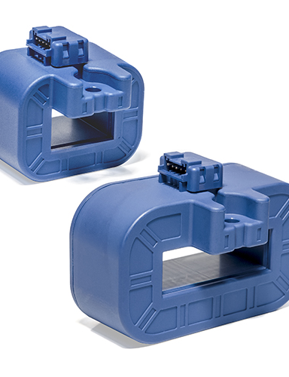
RENEWABLE ENERGIES

Slide 31
Key Sensors, By Technology
Technology | Series | Sub-Applications | Advantages | Standards
Air-Core (Current Transformer) | AK series AKR series AT series ATO1B1I series ATO1B225 series ATO1B333 series ATO1B420 series ATO2B1I series ATO2B225 series ATO2B333 series TT-SD series | Automation Systems Data Loggers Panel Meters VFD Controlled Loads SCR Controlled Loads Switching Power Supplier and Electronic Ballasts Hybrid Inverter (Home Energy Storage) Power Metering Building Sub-Metering Power Quality Monitoring Distributed Measurement Systems Condition Monitoring | Large Aperture High Insulation Between Primary and Secondary Circuits Compact case Cost-effective solution No interruption of electricity during installation on insulated conductors Quick, non-intrusive and easy setup Provide a calibrated output High accuracy and low phase shift Easy installation | IEC 61010-1: 2001 IEC 61326-1: 2005 IEC 61010-1 IEC 61326-1 IEC 61010-1: 2010 IEC 61010-031 ed1.1: 2012 IEC 61869-1 ed1.0: 2007 IEC 61869-2: ed1.0: 2012 IEC 61869-6: draft 2016 UL 508: 2013 IEC 61869-10: draft 2016
Air-Core (Prime) | AP series APR series | Automation Systems Panel Meters VFD Controlled Loads SCR Controlled Loads Switching Power Supplier and Electronic Ballasts | Large Aperture High Insulation Between Primary and Secondary Circuits Easy to Mount Eliminates Insertion Loss | IEC 61010-1
Air-Core (Rogowski) | ART series ARU series | MV/LV substations Power measurement Building sub-metering Power quality monitoring Fault Detection, Isolation and Repair (FDIR) Remote Terminal Units (RTU) Phasor Measurement Units (PMU) Outdoor Sub-stations Distribution Transformer Monitoring Underground Substations Pole-mounted Transformers Overhead Lines Distribution System Equipments | Thin, Flexible, and Lightweight Very Low Positioning Error Quick, Non-Intrusive, and Easy Set Up Large Current Range Without Overload Less Influenced by External Fields Adaptable for a large range of cable diameters Very Good Accuracy Does Not Saturate with Overcurrent and Short Circuits Fast and Easy Installation | IEC 61010-1: 2010 IEC 61010-2-32: 2012 IEC 61869-1: 2007 IEC 61869-2: 2012 IEC 61869-6: 2016 IEC 61869-10: 2017 UL 61010-1: 2012
Source: LEM International Website

Slide 32
Key Sensors, By Technology
Technology | Series | Sub-Applications | Advantages | Standards
Closed loop Fluxgate C type | CV3 series CV4 series | Single or three phase inverters Propulsion and braking choppers Propulsion converters Auxiliary converters Battery chargers AC variable speed drives and servo motor drives Static converters for DC motor drives Uninterruptible Power Supplies (UPS) Power supplies for welding applications Railway overhead line voltage measurement | Excellent accuracy Very good linearity Low temperature drift Optimized response time Wide frequency bandwidth High immunity to external interference Low Disturbance in Common Mode No insertion losses Current overload capability High Bandwidth | EN 50155: 2007 EN 50121-3-2: 2015 EN 50178: 1997 EN 50121-3-2: 2016 IEC 61010-1
Closed loop Fluxgate CAS-CASR-CKSR type | CAS-NP series CASR-NP series CKSR-NP series | AC variable speed and servo motor drives Static converters for DC motor drives Battery supplied applications Uninterruptible Power Supplies (UPS) Switched Mode Power Supplies (SMPS) Power supplies for welding applications Solar inverters | Very low temperature coefficient of offset Very good dv/dt immunity LTS compatible footprint LTSR compatible footprint Reduced height Reference pin with two modes: Ref IN and Ref OUT Extended measuring range for unipolar measurement. Higher creepage distance/clearance | EN 50178: 1997 IEC 61010-1: 2010 UL 508: 2013 IEC 60950-1: 2006 IEC 61326-1: 2012 UL 508: 2010
Closed loop Fluxgate CTSR type | CTSR series | Wide Aperture Residual Current Measurement Leakage Current Measurement in Transformerless PV Inverters First Human Contact Protection of PV arrays Failure Detection in Power Sources Symmetrical Fault Detection Leakage Current Detection in Stacked DC Sources Single Phase or Three Phase Nominal Current Measurement up to +-30 A Per Wire (DC or AC) | High Accuracy Very Low Offset Drift Over Temperature High Overload Capacity High Insulation Capacity Reference Pin With Two Modes, Ref IN and Ref OUT Degauss and Test Functions Possibility to Add up to Four Primary Wires (diameter 4.2 mm max) in Addition to the Already Integrated Primary Conductors | EN 50178: 1997 IEC 61010-1: 2010 UL 508: 2010
Open loop Fluxgate CAB type | CDSR-NP series CDSR-TP series | Leakage current measurement in an IC-CPD in-cable (mode 2) and for wall boxes (mode 3) contact and protection device Single phase nominal current up to ±32 A RMS | Very low error at small currents High overload capability High insulation capability Test winding | IEC 61851-1: 2017 IEC 62752: 2016 IEC 62955: 2018 UL 2231-1: 2012 UL 2231-2: 2012 UL 2594: 2016
Source: LEM International Website

Slide 33
Key Sensors, By Technology
Technology | Series | Sub-Applications | Advantages | Standards
Closed loop Hall effect | LA100P series LA125 series LA130150 series LA200P series LA205 series LA255 series LA25NP series LA305 series LA306 series LA35NP series LA55 series LAH series, & LAH125 series LAX100NP series LDSR-NP series, & LDSR-TP series LES series, & LESR series LF1005S series, & LF1010-S series LF2005 series, & LF2010-S series LF205 series, & LF210-S series LF305 series, & LF306 series LF310-S series LF505S series, & LF510-S series LH series LKSR series LPSR series LT10000 series LT1005 series LT2005 series LT4000 series LT505 series LV100 series, & LV100xx series LV200 series LV25 series, & LV25xx series LXS series, & LXSR series LZSR-P series, & LZSR-TP series | AC variable speed drives and servo motor drives Static converters for DC motor drives Battery supplied applications Uninterruptible Power Supplies (UPS) Switched Mode Power Supplies (SMPS) Power supplies for welding applications Leakage current measurement in transformerless PV inverters Failure detection in power sources Symmetrical fault detection Current leakage detection in stacked DC sources Solar inverters Windmill inverters First human contact protection of PV arrays Nominal current per phase measurement up to ±30 A per wire (DC or AC) Single phase nominal current measurement up to ±35 A per wire (DC or AC) Substations Single or three phase inverter Propulsion and braking chopper Propulsion converter Auxiliary converter Battery charger Railway overhead line voltage measurement | Excellent accuracy Very good linearity Optimized response time Wide frequency bandwidth No insertion losses High immunity to external interference Optimized delay time Height less than 16.5 mm for a simplified integration with power modules Low primary inductance Very low offset drift temperature coefficient High overload capability High insulation capability Test winding Very good dv/dt immunity CAS footprint compatible CASR footprint compatible Reference pin with two modes: Ref IN and Ref OUT Extended measuring range for unipolar measurement High immunity to external interference CKSR footprint compatible Low disturbance in common mode Low thermal drift interference LTS footprint compatible LTSR footprint compatible | EN 50178: 1997 UL 508: 2010 UL508 - UR marking IEC 61010-1-safety EN 61800-1: 1997 EN 61800-3: 2004 UL 62109-1: 2010 IEC 61010-1: 2010 IEC 61800-1: 1997 IEC 61800-2: 2015 IEC 61800-5-1: 2007 IEC 62109-1: 2010 IEC 62477-1: 2012 UL 508:2013 IEC 61800-1: 2004 IEC 61800-3: 2011 EN 50155: 2017 EN 50121-3-2: 2016 EN 50155: 2021 IEC 61800-3: 2017 UL 508: 2018
Source: LEM International Website

Slide 34
Key Sensors, By Technology
Technology | Series | Sub-Applications | Advantages | Standards
Open loop Hall effect | AHR series DHR series DK series GO-SME series GO-SMS series HAC/HEC series HAIS series HAL series HAS series HASS series HAT series HAX series HAZ series HLSR series HLSR-PW series HLSR-SM series HMSR-SMS series HO series HO-P series HOB series HOP series HOxx-NP- series HOxx-NPW series HOxx-P- series HOxx-PW- series HOxx-S- series HOxx-SW- series HOYL series HOYS series HTA series HTB series HTFS series HTR series HX series HXN series HXS series HY series | AC power supplies or Motors True RMS current sensing VFD Controlled Loads VFD output current monitoring SCRs or Swith-mode Rectifiers Renewable Energy Installations or Backup Batteries Continuous condition minitoring Switching Power Supplies and Electronic Ballasts Battery Banks Power Supplies Electric Heating Elements Small drives HVAC inverters Solar inverters E-Bikes AC variable speed drives and servo motor drives Static converters for DC motor drivers Battery supplied applications Uninterruptible Power Supplies (UPS) Switched Mode Power Supplies (SMPS) Power suppliers for welding applications DC motor drives Combiner box Solar inverter on DC side of the inverter (MPPT) Plasma cutter, welding Charging station Power supplies for TELECOM (monitoring & measuring) Electrical chemistry Chopper Forklift Devices Electrical appliances General purpose inverters | High insulation between primary and secondary circuits Eliminates insertion loss Large aperture for cable up to Ø32mm High isolation between primary and secondary circuits Extended Measuring Range Open loop multi-range current transducer Low electrical resistance Dual supply voltage Low power consumption High bandwidth No magnetic hysteresis Galvanic separation between primary and secondary Insulated test voltage Small footprint with standard surface mount PCB mounting Dual overcurrent detection Small size and space saving Only one design for wide current ratings range High immunity to external interference Extremely low profile Over-drivable Vref & Uref Reinforced insulation capability High resolution Lightning impulse current ≤ 20 kA. High insulation capability Fast Response High cut-off frequency > 1 MHz Very good linearity, and accuracy Low temperature drift Wide frequency bandwidth Easy to mount split core with automatic handling system | EN 50178: 1997 IEC 61010-1 IEC 61010-1 : 2001 IEC 61326-1: 2005 IEC 61800-5-1: 2007 IEC 62109-1: 2010 IEC 62368-1:2018 UL 1577: 2014 UL 62368: 2019 UL 508:2010 IEC 61000-6-2:2016 IEC 61800-3:2017 IEC 61010-1:2010 IEC 61477-1:2012 IEC 61800-2:2012 UL 508: 2013 EN 50155: 2007 EN 50121-3-2: 2006 IEC 61010-1: 2010 IEC 61326-1: 2012 UL 508: 2010 IEC 61800-2: 2015 IEC 61800-3: 2017 IEC 60950-1: 2005 IEC 61010-1: 2017 IEC 61010-2-30: 2017 IEC 61800-1: 1997 IEC 61800-3: 2004 EN 50178: 1998 EN 50178: 1999
Source: LEM International Website

Slide 35
Key Sensors, By Technology
Technology | Series | Sub-Applications | Advantages | Standards
Energy Meter | DCBM series EM4TII series | Electric Vehicle Charging infrastructures Data centers DC grids & Energy Monitoring Energy storage, renewables Railway Applications Energy measurement on board trains Electronic equipment used on rolling stock | Easy integration into systems Flexible integration with busbars or cables OCMF readouts compliant with S.A.F.E Compliant for energy billing or parking time billing System monitoring | EN 50470-1: 2006 EN 50470-3: 2006 PTB-A 50.7 PTB-A 20.1 CISPR32 Class-B emission IEC 62052-11: 2003 IEC 61000-6-2: 2016 IEC 61000-6-3: 2016 UL94-V0 EN 50463-x (2012) EN 50155 (2007) EN 50121-3-2 (2006) EN 61373 (2010) EN 50124-1 (2001) IEC 62056-21 (2002)
Eta (Hall Effect) | LAS series | AC variable speed drives and servo motor drives Static converters for DC motor drives Battery supplied applications Uninterruptible Power Supplies (UPS) Switched Mode Power Supplies (SMPS) Power supplies for welding applications. | Excellent accuracy Very good linearity Low temperature drift Optimized response time Wide frequency bandwidth No insertion losses High immunity to external interference Current overload capability. | EN 50178: 1997
Integrator | AI-PMUL series | MV/LV substations: transformer condition monitoring Power measurement: current measurement for active power calculation Building sub-metering: energy efficiency monitoring, consumption analysis and cost allocation Power quality monitoring: electrical loads and distribution system equipment Fault Detection, Isolation and Repair (FDIR) Remote Terminal Units (RTU) | Compact design for DIN rail assembly High accuracy Class 0.5 (IEC 61869-2) Setup by user via Select / Edit buttons Clear status indication via bi-color led | IEC 61010-1: 2010 IEC 61326-1: 2012
Source: LEM International Website

Slide 36
Key Sensors, By Technology
Technology | Series | Sub-Applications | Advantages | Standards
Insulation Digital Technology | DV series DVL series DVM series DVM-B series DVM-DT series DVM-UI series | Single or three phase inverters Propulsion and braking choppers Propulsion converters Auxiliary converters High power drives Substations On-board energy meters Energy metering Railway (fixed installation and onboard) Trackside AC variable speed and servo motor drives Static converters for DC motor drives Battery supplied applications Uninterruptible Power Supplies (UPS) Switched Mode Power Supplies (SMPS) Power supplies for welding applications | Low consumption and low losses Compact design Good behavior under common mode variations Excellent accuracy (offset, sensitivity, linearity) Response time 60 μs Low temperature drift High Immunity to External Interferences Very low sensitivity to common mode voltage variations Fast delay time | EN 50155: 2017 EN 50124-1: 2017 EN 50121-3-2: 2016 EN 50463 series: 2017 EN 50178: 1997 EN 50124-1: 2001 EN 50121-3-2: 2006 UL 508: 2013 EN 50155: 2021 IEC 62497-1: 2010 IEC 61010-1: 2010 IEC 62477-1: 2012 UL 347: 2016 IEC 61800-1: 1997 IEC 61800-2: 2015 IEC 61800-3: 2004 IEC 61800-5-1: 2007 IEC 62109-1: 2010 UL 347 1: 2016
Isolation Amplifier | DVC series DVC-B series DVC-P series DVC-UI series | AC variable speed and servo motor drives Static converters for DC motor drives Battery supplied applications Uninterruptible Power Supplies (UPS) Power supplies for welding applications Single or three phase inverters Auxiliary converters Substations | Low consumption and low losses Compact design Very low sensitivity to common mode voltage variations Excellent accuracy (offset, sensitivity, linearity) Fast delay time Low temperature drift High immunity to external interferences | EN 50155: 2021 EN 50121-3-2: 2016 IEC 62497-1: 2010 IEC 61000-6-2: 2016 IEC 61000-6-4: 2016 IEC 61800-3: 2005 IEC 61010-1: 2010 IEC 61800-5-1: 2007 IEC 62109-1: 2010 UL 508: 2018 EN 50155: 2017 IEC 61000-6-3: 2016
Source: LEM International Website

Slide 37
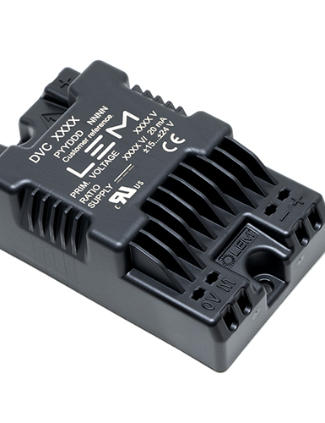
TRACTION

Slide 38
Key Sensors, By Technology
Technology | Series | Sub-Applications | Advantages | Standards
Closed loop Fluxgate C type | CD series CV3 series CV4 series | Railway Security System Single or three phase inverters Propulsion and braking choppers Propulsion converters Auxiliary converters Battery chargers AC variable speed drives and servo motor drives Static converters for DC motor drives Uninterruptible Power Supplies (UPS) Power supplies for welding applications Railway overhead line voltage measurement | Excellent accuracy Very good linearity Low temperature drift Low Delay Time High Bandwidth Low Insertion Loss in the Circuit to be Measured High immunity to external interference Current Overloads Supported Without Damage Optimized response time Wide frequency bandwidth Low Disturbance in Common Mode | EN 50155 EN 50155: 2007 EN 50121-3-2:2015 EN 50178: 1997 EN 50121-3-2: 2016
Closed loop Fluxgate CAS-CASR-CKSR type | CAS-NP series CKSR-NP series | AC variable speed and servo motor drives Static converters for DC motor drives Battery supplied applications Uninterruptible Power Supplies (UPS) Switched Mode Power Supplies (SMPS) Power supplies for welding applications Solar inverters | Very low temperature coefficient of offset Very good dv/dt immunity Higher creepage distance/clearance Reduced height Reference pin with two modes: Ref IN and Ref OUT Extended measuring range for unipolar measurement LTS compatible footprint | EN 50178: 1997 IEC 60950-1: 2006 IEC 61010-1: 2010 IEC 61326-1: 2012 UL 508: 2010 UL 508: 2013
Closed loop Fluxgate ITC type | ITC series | Fixed and Onboard Traction | Excellent accuracy (better than class 0.5R) Low consumption and low losses Good behavior under common mode variations High Bandwidth Low temperature drift High immunity to external interferences. | EN 50155: 2007 EN 50124-1: 2001 EN 50121-3-2: 2016 EN 50436: 2012 IEC 61869-1: 2007 IEC 61869-2: 2012 IEC 61869-6: 2016
Source: LEM International Website

Slide 39
Key Sensors, By Technology
Technology | Series | Sub-Applications | Advantages | Standards
Closed loop Hall effect | LA125 series LA200P series LA205 series LA25NP series LA305 series LA500SD series LAC series LES series LF1005S series LF1010-S series LF2005 series LF2010-S series LF205 series LF210-S series LF305 series LF310-S series LF505S series LF510-S series LT1005 series LT100S&T series LT2005 series LT4000 series LT505 series LTC1000 series LTC2&400 series LTC500 series LV100 series LV100xx series LV25 series LXS series LXSR series PCM series | AC variable speed drives and servo motor drives Static converters for DC motor drives Battery supplied applications Uninterruptible Power Supplies (UPS) Switched Mode Power Supplies (SMPS) Power supplies for welding applications Single Phase or Three Phases Inverter Propulsion and Braking Chopper Propulsion Converter Auxiliary Converter Battery Charger Energy Meter Solar inverters Windmill inverters Test and measurement Substations Points condition monitoring Signal light indication | Excellent accuracy Very good linearity Low temperature drift Optimized response time Wide frequency bandwidth No insertion losses High immunity to external interference Current overload capability Very good dv/dt immunity CAS footprint compatible Very low offset drift over temperature Optimized delay time Low disturbance in common mode LTS footprint compatible Extended measuring range for unipolar measurement LTSR footprint compatible Reference pin with two modes: Ref IN and Ref OUT Non-contact measurement (does not need a safety case) | EN 50155: 1995 IEC 61000-4-3 EN 50155: 2017 UL 508: 2010 EN 50121-3-2: 2016 IEC 61800-1: 1997 IEC 61800-2: 2015 IEC 61800-3: 2004 IEC 61800-5-1: 2007 IEC 62109-1: 2010 IEC 62477-1: 2012 UL 508:2013 IEC 61010-1: 2010 IEC 61800-1: 2004 IEC 61800-3: 2011 EN 50178:1997 EN 50155: 2021 EN 50121-4: 2001 EN 50121-3-2: 2015
Source: LEM International Website

Slide 40
Key Sensors, By Technology
Technology | Series | Sub-Applications | Advantages | Standards
Open loop Hall effect | HAR series HAZ series HTC series HTRS series | Single or three phase inverters Propulsion and braking choppers Propulsion converters Auxiliary converters Battery chargers AC variable speed drives and servo motor drives Static converters for DC motor drives Battery supplied applications Uninterruptible Power Supplies (UPS) Switched Mode Power Supplies (SMPS) Power supplies for welding applications Points condition monitoring Signal light indication | Excellent accuracy Very good linearity Low temperature drift Optimized delay time Wide frequency bandwidth No insertion losses High immunity to external interference Current overload capability Easy installation Small size and space savings Only one design for wide current rating range Low power consumption Non-contact measurement (does not need a safety case) | EN 50155: 2007 EN 50178: 1997 EN 50121-3-2: 2006 UL508 : 2010 EN 50121-4 : 2015 EN 50124-1 : 2017 EN 50125-3 : 2003 IEC 61000-6-4:2018
Air-Core | RA series | Single or three phase inverters Propulsion and braking choppers Propulsion converters. | No insertion losses Current overload capability | EN 50155: 2017 EN 50121-3-2: 2016
Energy Meter | EM4TII series | Railway Applications Energy measurement on board trains Electronic equipment used on rolling stock | Easy integration into systems Flexible integration with busbars or cables OCMF readouts compliant with S.A.F.E Compliant for energy billing or parking time billing System monitoring | EN 50463-x (2012) EN 50155 (2007) EN 50121-3-2 (2006) EN 61373 (2010) EN 50124-1 (2001) IEC 62056-21 (2002)
Source: LEM International Website

Slide 41
Key Sensors, By Technology
Technology | Series | Sub-Applications | Advantages | Standards
Insulation Digital Technology | DV series DVL series DVM series DVM-B series DVM-DT series DVM-UI series | Single or three phase inverters Propulsion and braking choppers Propulsion converters Auxiliary converters High power drives Substations On-board energy meters AC variable speed and servo motor drives Static converters for DC motor drives Battery supplied applications Uninterruptible Power Supplies (UPS) Power supplies for welding applications Switched Mode Power Supplies (SMPS) Renewable Energy (Solar and Wind) Trackside Railway (fixed installations and onboard) | Low consumption and low losses Compact design Excellent accuracy (offset, sensitivity, linearity) Response time 60 μs Low temperature drift Good Delay Time Very low sensitivity to common mode voltage variations High immunity to external interferences | EN 50155: 2017 EN 50124-1: 2017 EN 50463 series: 2017 EN 50178: 1997 UL 508: 2013 IEC 61010-1: 2010 EN 50155: 2021 EN 50121-3-2: 2016 IEC 62497-1: 2010 IEC 62477-1: 2012 UL 347: 2016 IEC 61800-1: 1997 IEC 61800-2: 2015 IEC 61800-3: 2004 IEC 61800-5-1: 2007 IEC 62109-1: 2010 UL 347 1: 2016
Isolation Amplifier | DVC series DVC-B series DVC-P series DVC-UI series DVM-DT series DVM-UI series | AC variable speed and servo motor drives Static converters for DC motor drives Battery supplied applications Uninterruptible Power Supplies (UPS) Power supplies for welding applications Single or three phase inverters Auxiliary converters Substations Propulsion and braking choppers Propulsion converters High power drives Trackside Railway (fixed installations and onboard) | Low consumption and low losses Compact design Very low sensitivity to common mode voltage variations Excellent accuracy (offset, sensitivity, linearity) Fast delay time Low temperature drift High immunity to external interferences | EN 50155: 2021 EN 50121-3-2: 2016 IEC 62497-1: 2010 IEC 61000-6-2: 2016 IEC 61000-6-4: 2016 IEC 61800-3: 2005 IEC 61010-1: 2010 IEC 61800-5-1: 2007 IEC 62109-1: 2010 EN 50155: 2017 IEC 61000-6-3: 2016 UL 508: 2018 EN 50124-1: 2017 IEC 61800-1: 1997 IEC 61800-2: 2015 IEC 61800-3: 2004 UL 347: 2016 IEC 62477-1: 2012 UL 347 1: 2016
Source: LEM International Website

Slide 42
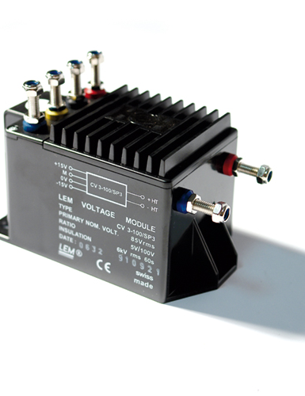
HIGH PRECISION

Slide 43
Key Sensors, By Technology
Technology | Series | Sub-Applications | Advantages | Standards
Closed loop Fluxgate C type | CV3 series | Single or three phase inverters Propulsion and braking choppers Propulsion converters Auxiliary converters Battery chargers | Excellent accuracy Very good linearity Low temperature drift Optimized response time Wide frequency bandwidth High immunity to external interference Low Disturbance in Common Mode | EN 50155: 2007 EN 50121-3-2: 2015
Closed loop Fluxgate IN type | IN-->400 series IN2000 series IN500-1K series | Feedback element in high performance gradient amplifiers for MRI Feedback element in high-precision, high-stability power supplies Calibration unit Energy measurement Medical equipment | Very high accuracy Excellent linearity Extremely low temperature drift Wide frequency bandwidth High immunity to external fields No insertion losses Very low noise on output signal | EN 61000-6-2: 2016 EN 61000-6-3: 2007 + A1 (2011) EN 61010-1: 2010 + A1 (2016) IEC 61010-2-030: 2017 EN 61000-6-2: 2005 EN 61000-6-3: 2007 EN 61010-1: 2010
Closed loop Fluxgate IT type | ITL4000 series ITL900 series ITN series ITN6&900 series ITZ series | HVDC (VSC Technology) Medium voltage PFC and active filters Small DC component detection in large AC currents (transformer protection) Feedback element in high performance gradient amplifiers for MRI Feedback element in high-precision current regulated devices Energy measurement Medical equipment Precise and high stability inverters Absolute Current Standard Reference Test and Calibration of Current Sources Current Extender of Power Systems Differential Current Measurement on Power Line Metrology Application | Integrated design Low cost Large aperture Very high accuracy Excellent linearity Extremely low temperature drift Wide frequency bandwidth High immunity to external fields Negligible self-magnetism Current overload capacity Very low noise on output signal Low noise feedback to primary conductor High resolution No insertion losses | IEC 61010-1: 2010 IEC 61869-1: 2007 IEC 61869-2: 2012 IEC 61869-6: 2016. EN 50178: 1997 IEC 61010-1: 2010 EN 50178: 1997 IEC 61010-1: 2010 EN 61000-6-2: 2005 EN 61000-6-3: 2007 EN 61010-1: 2010 EN 61010-1: 2001 EN 61326-1: 2006 EN 61000-3-2: 2006 EN 61000-3-3: 1995 + A1: 2001 + A2: 2005
Source: LEM International Website

Slide 44
Key Sensors, By Technology
Technology | Series | Sub-Applications | Advantages | Standards
Fluxgate | CAB-SF series | Hybrid and electric vehicle battery pack Conventional lead-acid batteries Accurate current measurement for battery management applications (SOC, SOH, SOF, etc.). | Offset below 10 mA Total error [−40 °C to 85 °C] 0.5 % typical total error at 1-sigma 0.8 % total error at 3-sigma Full galvanic separation. | IEC60068-2-60 (12/1996) IEC 61000-4-2 (2008)
Power Supply | IST series | Laboratory setup Industrial test bench Analogue current measurement frontend for multi-input power analyzer, e.g., for 3-phase measurements on AC motors, power inverters etc. | Convenient solution when operating 1 to 6 IT/ITN transducers in one setup Integrates in standard 19’’ rack system typically used in laboratory and industrial test setups The output current version allows measurement signal to travel long distances by using external burden resistor, i.e., current-to-voltage conversion is done by a precision resistor in attached measurement system (e.g.: Power Analyzer, etc.). | IEC 61010-1: 2001 IEC 61000-6-2: 2005 IEC 61000-6-4 : 2007 EN 61326-1 (2013)
Source: LEM International Website

Slide 45
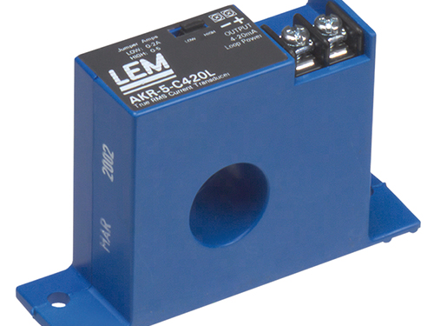
KEY PARTNER ALLIANCES ACROSS REGIONS - INDUSTRIAL TRANSDUCER BUSINESS DOMAIN

Slide 46
Key Partner Alliances Across Regions
Industrial Transducer Business Domain
Company Name | Location | Type
Darrah Electric Company | US | Dealer/Distributor
Distrelec-Schuricht | Austria, Belgium, Czech Republic, Germany, Holland, Hungary, Italy, Luxemburg, Poland, Slovakia, Switzerland | Dealer/Distributor
FARNELL-in-one | Austria, Belgium, Denmark, Finland, France, Germany, Italy, the Netherlands, Norway, Portugal, Sweden, Switzerland, Spain, United Kingdom, India | Dealer/Distributor
RS Components | Austria, Belgium, China, Denmark, Finland, France, Germany, Italy, The Netherlands, Norway, Poland, Portugal, Spain, Sweden, United Kingdom, Japan | Dealer/Distributor
Newtons4th Ltd | United Kindgom | Dealer/Distributor
Signaltec GmbH | Germany | Dealer/Distributor
Digi-key | Argentina, Armenia, Australia, Austria, Belarus, Belgium, Bolivia, Bosnia and Herzegovina, Brazil, Bulgaria, Canada, Chile, China, Colombia, Costa Rica, Croatia, Cyprus, Czech Republic, Denmark, Dominican Republic, Ecuador, Egypt, Estonia, Finland, France, Germany, Greece, Guatemala, Hong Kong, Hungary, Iceland, India, Indonesia, Ireland, Israel, Italy, Jamaica, Japan, Latvia, Lebanon, Lithuania, Luxembourg, Macedonia, Malaysia, Mexico, Moldova, Morocco, Netherlands, New Zealand, Norway, Pakistan, Panama, Peru, Philippines, Poland, Portugal, Puerto Rico, Romania, Russia, Saudi Arabia, Serbia, Singapore, Slovak, Slovenia, South Africa, South Korea, Spain, Sri Lanka, Sweden, Switzerland, Taiwan, Thailand, Tunisia, Turkey, Ukraine, United Arab Emirates, United Kingdom, United States, Uruguay, Venezuela, Vietnam | Dealer/Distributor
Globetek | India | Dealer/Distributor
Source: TechSci Research

Slide 47
Key Partner Alliances Across Regions
Industrial Transducer Business Domain
Company Name | Location | Type
Proteus Electric | Croatia | Dealer/Distributor
PE & ED Spol. S.R.O. | Czech Republic | Dealer/Distributor
Deltron-Conelec A/S | Denmark | Dealer/Distributor
Etra-Dielectric Oy | Finland | Dealer/Distributor
Hauber & Graf Electronics GmbH | Germany | Dealer/Distributor
Orszaczky Trading LTD. | Hungary | Dealer/Distributor
Ofer Levin Technological Application | Israel | Dealer/Distributor
Holst & Fleischer A/S | Norway | Dealer/Distributor
DACPOL Sp. z o.o. | Poland | Dealer/Distributor
QEnergia, Lda (Infocontrol) | Portugal | Dealer/Distributor
SYSCOM -18 Srl. | Romania | Dealer/Distributor
TVELEM | Russia | Dealer/Distributor
Proteus Electric | Slovenia | Dealer/Distributor
AVANZEL COMPONENTES, S.L. | Spain | Dealer/Distributor
SIMPEX Electronic AG | Switzerland | Dealer/Distributor
Özdisan Electronik Pazarlama | Turkey | Dealer/Distributor
Optimum Components Inc. | Canada | Dealer/Distributor
Denver Technical Products Ltd. | South Africa | Dealer/Distributor
Fastron Technologies Pty Ltd. | Australia and New Zealand | Dealer/Distributor
NANALEM K.K. | Japan | Dealer/Distributor
Youngwoo Ind. Co. | Korea | Dealer/Distributor
Source: TechSci Research

Slide 48
Key Partner Alliances Across Regions
Industrial Transducer Business Domain
Company Name | Location | Type
Overseas Trade Center Ltd. | Singapore | Dealer/Distributor
Tope Co., Ltd. | Taiwan | Dealer/Distributor
Denver Technical Products (Pty) Ltd | South Africa | Dealer/Distributor
SEMAK SA | Argentina | Dealer/Distributor
POWERTRONICS CO. LTD | Taiwan | Dealer/Distributor
Direct Customers
Company Name | Location | Type | Basic Description
HORIBA, Ltd. | Japan | Direct | Manufactures automotive emission measurement systems, environmental measuring instruments, wide range of scientific analyzers, and medical diagnostic analyzers, and measuring equipment. Uses LEM products to manufacture high precision detection equipment.
Intech Engenharia Ltd | Brazil | Direct | Intech Engenharia is an engineering company covering infrastructure and civil construction works. Uses LEM products in manufacturing of construction machinery and equipment.
ElectroChile SpA | Chile | Direct | Operates in energy, lighting and electromobility business areas. Uses LEM products for providing renewable energies solutions.
Beving Elektronik A.B. | Sweden | Direct | Offers products to the electric power industry and the energy sector. Uses LEM products for providing power supplies solutions.
MikroElektronik | Serbia | Direct | Manufacturer of software and hardware tools for developing embedded solutions. Uses LEM products for manufacturing click boards which are used for AC variable drives, Servo motor control, Power supplies, etc. applications.
ACEI Systems SDN BHD | Malaysia | Direct | ACEI Systems SDN BHD is an engineering services company involving Uses LEM products to provide solutions for detection and monitoring of fault and disturbance in power generation facilities, and transmission and distribution substations.
Source: TechSci Research

Slide 49







Disclaimer :
The contents of this report are based on information generally available to the public from sources and primary interviews which are believed to be reliable. No representation is made that it is timely, accurate or complete. TechSci Research has taken due care and caution in compilation of data as this has been obtained from various sources including primary interviews which it considers reliable and firsthand. However, TechSci Research does not guarantee the accuracy, adequacy or completeness of any information and it is not responsible for any errors or omissions or for the results obtained from the use of such information and especially states that it has no financial liability whatsoever to the subscribers / users of this report. The information herein, together with all estimates and forecasts, can change without notice. All the figures provided in this document are indicative of relative market size and are strictly for client’s internal consumption. Usage of the same for purpose other than internal will require prior approval of TechSci Research.
CONTACT US
TechSci Research – North America
2950, Boundary Road, Burnaby, British Columbia, Canada
Tel: +1- 646- 360-1656
E: sales@techsciresearch.com
TechSci Research – Europe
54, Oldbrook, Bretton,
Peterborough,
United Kingdom
E: sales@techsciresearch.com
TechSci Research – Asia-Pacific
B-44, Sector -57, Noida, National Capital Region, UP, India
Tel: +91-120-4523900
E: sales@techsciresearch.com
TechSci Research
Cyber City, Building No. 8C, Gurgaon, National Capital Region, Haryana, India
Tel: +91-124-6428661
E: sales@techsciresearch.com
www.techsciresearch.com
INDUSTRY ASSOCIATIONS
The information contained herein is of a general nature and is not intended to address any particular situation, individual or entity. No one should act upon such information without appropriate professional advice.
2021 © TechSci Research All Rights Reserved.

